Slide 1

AtliQ Grands
Hospitality is our Passion

Slide 2
Business Model & Problem Statement
AtliQ Grands owns multiple five-star hotels across India
They have been in the hospitality industry for the past 20 years
Have property in 4 cities – Mumbai, Delhi, Bangalore and Hyderabad
Their main revenue is from luxury/business hotels category
Decrease in Revenue: AtliQ Grands are losing its market share and revenue due to strategic moves from other competitors and ineffective decision-making in management

Slide 3

Understand the data model
Data Tables
Dimension Tables Fact Tables
Date
Bookings data
(All business transactions)
Hotels
Rooms

Slide 4
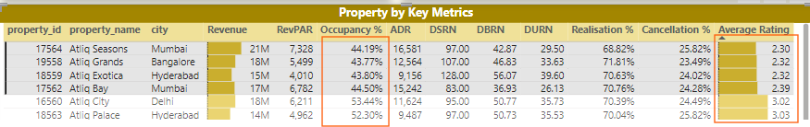
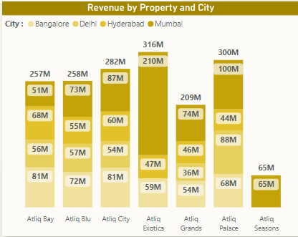
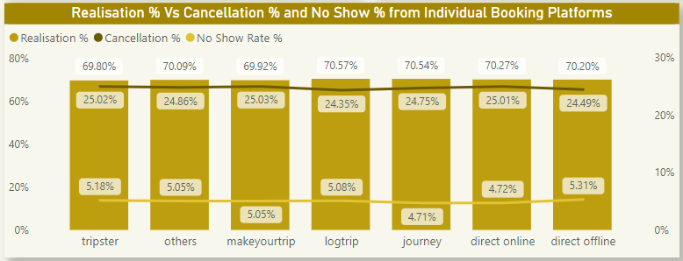
Insights and Key Findings
Properties which have Rating below 3 are having less Occupancy %
Booking Realisation % is around 70% across all booking platforms but cancellation % and No Show Rate% is impacting the revenue
Major revenue is coming from Atliq Exotica from Mumbai
Least revenue is coming from Atliq Grands from Delhi
Mumbai – Top in revenue generating
Bangalore – Bottom in revenue generating

Slide 5
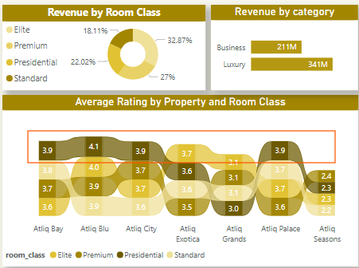
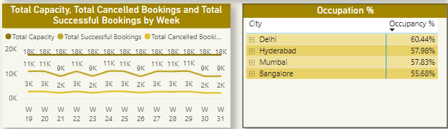
Insights and Key Findings
Majority of the revenue is coming from Luxury category
Major revenue comes from Elite Class rooms but top rated room class from customers is Presidential
Most of the weeks, Total Capacity across property is 18000 rooms for any given time, but successful room bookings happened is between 9000 - 11000 rooms.
Total rooms cancelled are between 2000 – 3000 rooms.
Delhi and Bangalore are the top and bottom cities w.r.t occupancy % respectively

